Slide 1
Elastic Compute Cloud (EC2)

Slide 2
Amazon EC2:
Amazon Elastic Compute Cloud (Amazon EC2) provides scalable computing capacity in the Amazon Web Services (AWS) cloud.
Using Amazon EC2 eliminates your need to invest in hardware up front, so you can develop and deploy applications faster.
You can use Amazon EC2 to launch as many or as few virtual servers as you need, configure security and networking, and manage storage.
Amazon EC2 enables you to scale up or down to handle changes in requirements or spikes in popularity, reducing your need to forecast traffic.

Slide 3
Types of EC2 instances
Shared
Dedicated instances
Dedicated hosts

Slide 4
When you launch an instance, the instance type that you specify determines the hardware of the host computer used for your instance.
Each instance type offers different compute, memory, and storage capabilities and are grouped in instance families based on these capabilities.
Amazon EC2 provides each instance with a consistent and predictable amount of CPU capacity, regardless of its underlying hardware.

Slide 5
Amazon EC2 dedicates some resources of the host computer, such as CPU, memory, and instance storage, to a particular instance.
Amazon EC2 shares other resources of the host computer, such as the network and the disk subsystem, among instances.
If each instance on a host computer tries to use as much of one of these shared resources as possible, each receives an equal share of that resource.
However, when a resource is underused, an instance can consume a higher share of that resource while it's available.

Slide 6
Each instance type provides higher or lower minimum performance from a shared resource.
For example, instance types with high I/O performance have a larger allocation of shared resources.
Allocating a larger share of shared resources also reduces the variance of I/O performance.
For most applications, moderate I/O performance is more than enough.
However, for applications that require greater or more consistent I/O performance, consider an instance type with higher I/O performance.

Slide 7
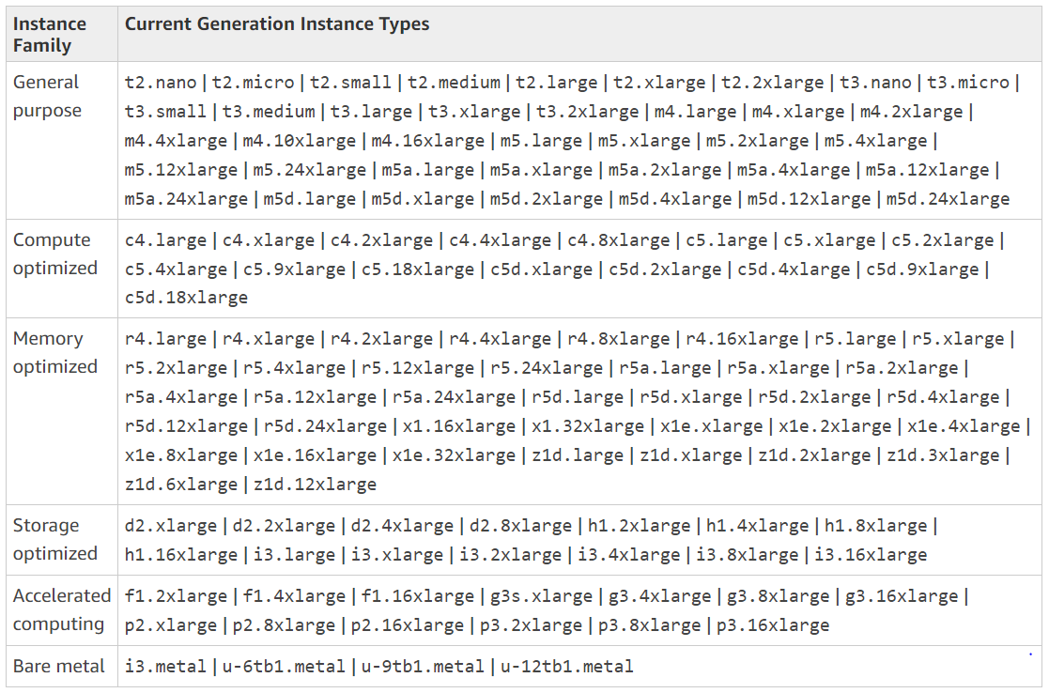
Available instance types
Current Generation Instances

Slide 8
Previous Generation Instances
Amazon Web Services offers previous generation instances for users who have optimized their applications around these instances and have yet to upgrade.
It is recommended to use the latest generation of instances to get the best performance, but we continue to support these previous generation instances.
If you are currently using a previous generation instance, you can see which current generation instance would be a suitable upgrade.

Slide 9
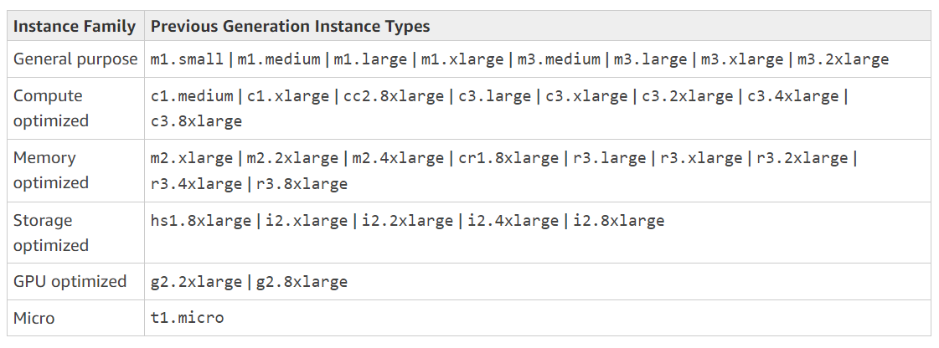

Slide 10
To determine which instance type best meets your needs, we recommend that you launch an instance and use your own benchmark application.
Because you pay by the instance second, it's convenient and inexpensive to test multiple instance types before making a decision.
If your needs change, even after you make a decision, you can resize your instance later.

Slide 11
Amazon EC2 provides different instance types to enable you to choose the CPU, memory, storage, and networking capacity that you need to run your applications.
Amazon EC2 supports On-Demand instances (the default), Spot instances, and Reserved Instances. For more information
Each instance is backed by Amazon EBS or backed by instance store. Select an AMI based on which type of root volume you need.

Slide 12
On-Demand Instances – Pay, by the second, for the instances that you launch.
Reserved Instances – Purchase, at a significant discount, instances that are always available, for a term from one to three years.
Scheduled Instances – Purchase instances that are always available on the specified recurring schedule, for a one-year term.
Spot Instances – Request unused EC2 instances, which can lower your Amazon EC2 costs significantly.
Dedicated Hosts – Pay for a physical host that is fully dedicated to running your instances, and bring your existing per-socket, per-core, or per-VM software licenses to reduce costs.
Dedicated Instances – Pay, by the hour, for instances that run on single-tenant hardware.
Capacity Reservations – Reserve capacity for your EC2 instances in a specific Availability Zone for any duration.

Slide 13
If you require a capacity reservation, purchase Reserved Instances or Capacity Reservations for a specific Availability Zone, or purchase Scheduled Instances.
Spot Instances are a cost-effective choice if you can be flexible about when your applications run and if they can be interrupted.
Dedicated Hosts can help you address compliance requirements and reduce costs by using your existing server-bound software licenses.

Slide 14
Private IP vs Public IP
Every EC2 has Private and Public Ips. Private IP is decided based on vpc attached and subnet associated with the EC2.
The scope of Private IP remains within the VPC.
Connection of any resource to ec2 inside VPC will happen through Private IP
For connecting to ec2 from any resource outside of it’s VPC will happen through Public IP
When we stop the ec2 machine the public IP gets released. When the same ec2 is started again there will be a new public IP address assigned to it. It’s a way of optimizing public Ips as they are limited (IPV4).

Slide 15
Elastic IP is a public IP but it is constant for ec2 instance.
Even after you stop and start your instance the IP will not change.
Need to create elastic IP and assign to ec2.
Elastic IP is free as long as it is attached to a running ec2.
You will be charged for it when you reserve it and do not use it or when you attach it to ec2 and stop that instance.

Slide 16
Pricing Options
On Demand (default mode) :
No Commitment
Pay by hour (any partial hour is considered full)
New billing cycle starts whenever instance changes to running state.
Billing cycle ends whenever instance move to stopping state (but not reboot).
On-Demand instances are recommended for:
Users that prefer the low cost and flexibility of Amazon EC2 without any up-front payment or long-term commitment
Applications with short-term, spiky, or unpredictable workloads that cannot be interrupted
Applications being developed or tested on Amazon EC2 for the first time

Slide 17
Reserved Instance
Committed instances (1 year or 3 years)
Payment Options( full upfront(pay everything in the start), partial upfront(pay a part of bill in the start and remaining comes in monthly bill), no upfront (not for 3year term))
Lot of saving when compared to On Demand and gives guaranteed capacity
There is an option to resell the reserved instance only in case there is a customer ready to buy.

Slide 18
Scheduled Reservation
If we want certain instances for lesser period and that too for shorter spans i.e. weekly, monthly etc (dev or test machines, some batch processing which we do weekly)
1 year term is available with our own schedule (either daily or weekly with exact timelines)
Obviously less pay compared to on demand instance.

Slide 19
Spot Instance
The unused capacity on AWS is prone for bidding.
We bid on it and if that bid is more than market price then we get it.
Spot market price fluctuates a lot . In case if the market price goes above our bid price then those instances are taken away or terminated with 2 min notice period where you can shift your activities from this instance. 2 mins of notice period should be good enough to act accordingly.
Bid price is hourly and in case AWS terminates it due to above context then the last partial hour is free.
Now there is an option called spot block where you can block the duration for which we can block spot instances irrespective of the spot price fluctuation. Max duration of spot block duration is 6 hours.

Slide 20
Dedicated Instances
Hourly rate is more than on demand instances as we get isolated resources.
Additional 2$ per hour if you subscribe for a dedicated instance (even if it is multiple dedicated instances it will be 2$ per hour).
Dedicated host → a complete independent host. You will be paying for full host irrespective of no. of ec2 running on it.

